Slide 1

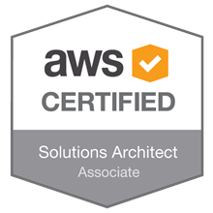
AWS- Solutions Architect
Presenter :- amir Khan

Slide 2

What is Cloud ?

Slide 3
Cloud computing is the on-demand delivery of compute power, database storage, applications, and other IT resources through a cloud services platform via the internet with pay-as-you-go pricing. Examples of cloud service providers- (Google,AWS,Azure)

Slide 4
How Does Cloud Computing Work?
Cloud computing provides a simple way to access servers, storage, databases and a broad set of application services over the Internet. A Cloud services platform such as Amazon Web Services owns and maintains the network-connected hardware required for these application services, while you provision and use what you need via a web application.
Six Advantages and Benefits of Cloud Computing
Trade capital expense for variable expense
Benefit from massive economies of scale
Stop guessing capacity
Increase speed and agility
Stop spending money on running and maintaining data centers
Go global in minutes

Slide 5
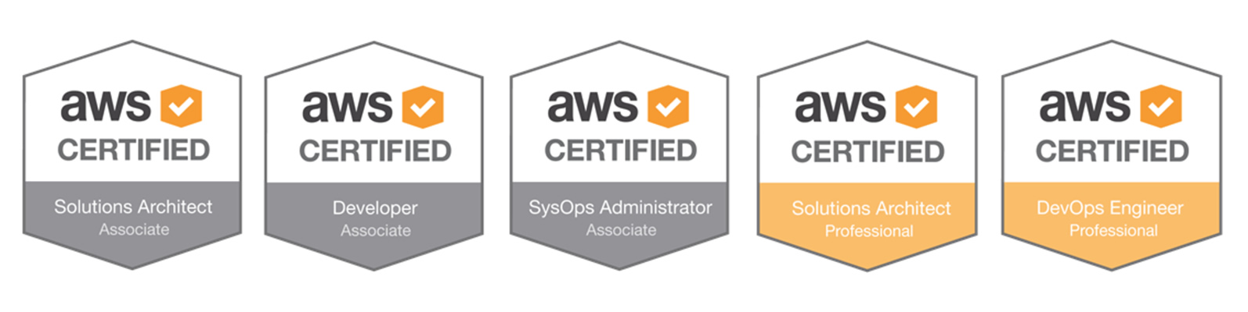
Why should you learn AWS ?
Article from Business Insider
AWS Certifications paths
Note :- There are two more specialty certs but in order to complete that you have to be at least certified to an associate level

Slide 6
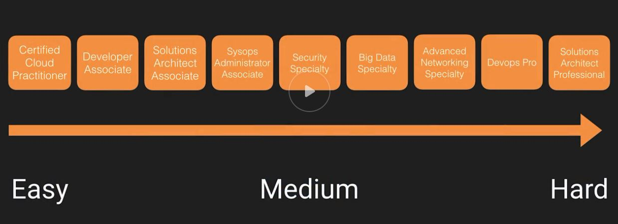
How the exams fit together ?
Pre-requiste :- Computer, AWS account
AWS releases their services very fast in order to keep up you can subscribe to the blog of Jeff Barr to check on updated
Jeff Barr Blog

Slide 7
Exam blueprint for AWS-SA
Currently there are two AWS-SA exams and the old exams would be retired in somewhere around September 2018
Comparison between the old and the new exams
Old Exam / New Exam
Exam preparation guide
Study Guide

Slide 8
History of AWS till 2018
Although you won’t be quizzed on this but It is good to know where AWS has come from and why you should get certified and what would you get out of it.
Before AWS how things used to work
In case you want to build webservers/app you have to get quotes from vendors and order physical servers. Once you have to servers you have to get it configured, rack and stack them in your DC apply your organization policies. This would generally take 15-20 days to even months
AWS started in 2003 when Chris Pinkhan and Benjamin Black presented a use case for this. They suggested it selling it as a service
SQS was the very first service that was launched in 2004
AWS was officially launched as a brand in 2006
By the end 0f 2007 more than 180,000 developers were on the platform using the services
2010 all the infrastructure running amazon.com moved over to AWS
2012 first re:invent conference was launched

Slide 9
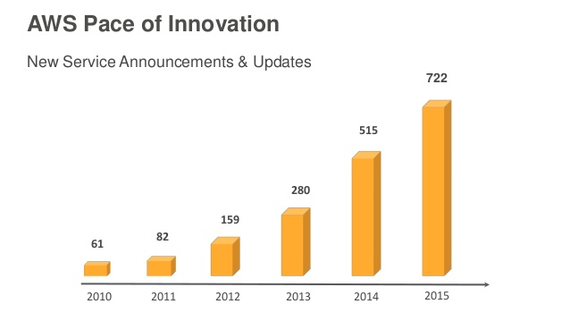
History of AWS till 2018
2013 Certification were launched
2015 AWS breaks its revenue and it was 6 Billion USD
2016 Run rate of 13 Billion USD
2017 they have launched a lot of AI services and VR services
New Services & Announcements

Slide 10
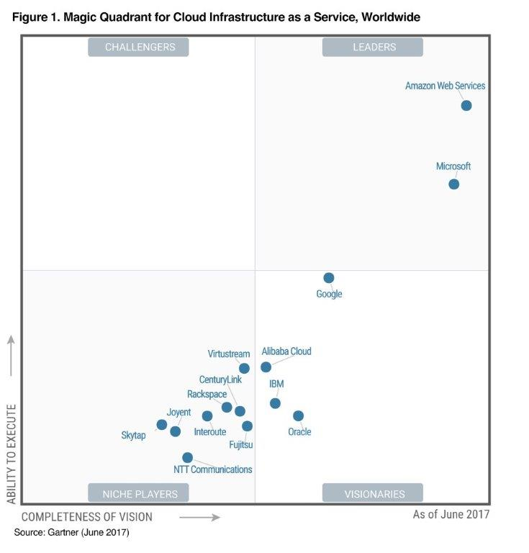
Gartner’s Magic Quadrant for CC
AWS was named as the leader for the 6th consecutive year in 2016
In June 2017 AWS was named as one of the leaders again

Slide 11
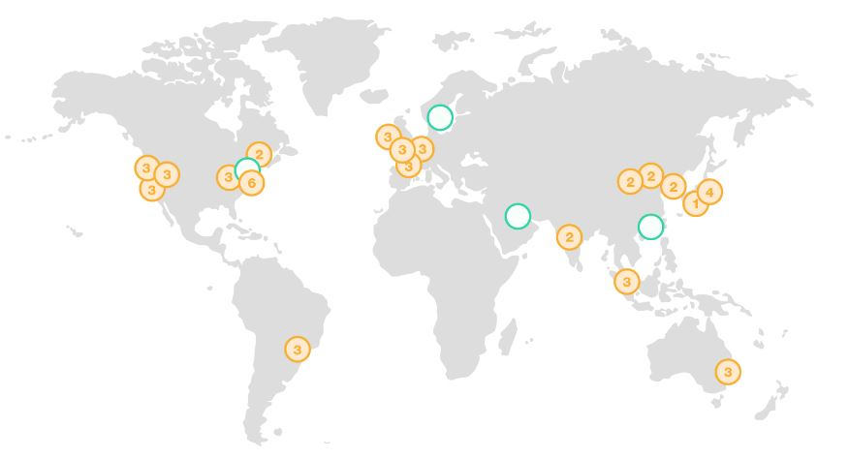
AWS Services– A Brief Overview
As we already know that there are more than 1300+ services and updates hence it would be difficult to elaborate every service in particular.
AWS Global infrastructure
This is nothing but the DC that are located across the world of which Amazon provide us the resources
More information on global infrastructure

Slide 12
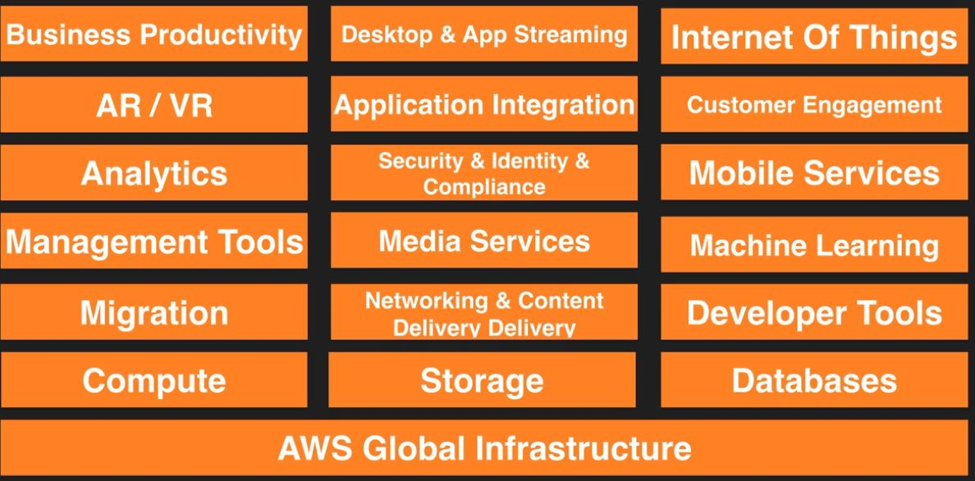
AWS Services– A Brief Overview
AWS Global infrastructure is the core that powers all the services for AWS.

Slide 13
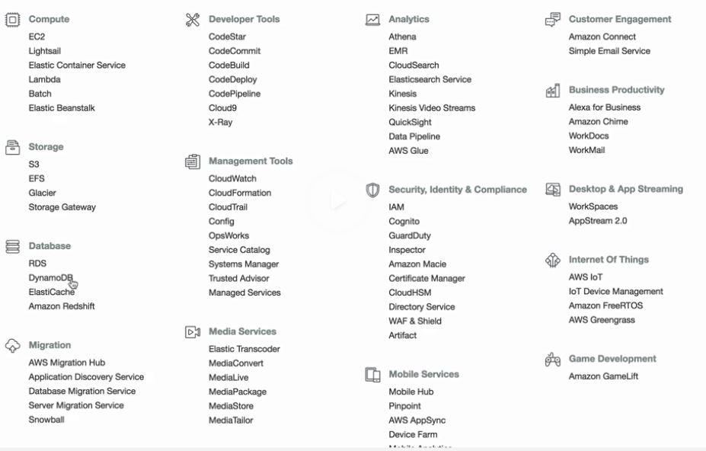
AWS Services– A Brief Overview
All the headings that I just showed you all is a specific category and the core services lies under them
NOTE :- The services that you see on the catalog depends on the regions that you are logged in

Slide 14
AWS Services– A Brief Overview
AWS Global infrastructure is divided in Regions and AZ
What is a Region & AZ ?
Regions are Geographical area which are located at very far distance from each other even thousand of miles
Region comprises of AZ or Availability zones and each region consists of 2 or more AZ
An AZ is simply a Data Center or a group of DC’s which is located in a region and is far enough apart from other AZ within the same region so that in case of any failure of one AZ would not affect the other.
What is Edge locations ?
Edge locations are endpoint for AWS that is used to cache content, typically they are used as a CDN. Edge locations are many in number as compared to Regions and AZ.
NOTE :- You should always architect for High Availibility so to speak you should always keep your resources in different AZ.

Slide 15
AWS Services– A Brief Overview
Compute
EC2 :- Elastic compute cloud, these are essentially VM in the AWS cloud and you access them via SSH or RDP
ECS :- Elastic container service wherein you manage and run Docker containers.
Elastic Beanstalk :- This provides a platform wherein you upload the code and the service would provision the underlying infrastructure for your code
Lambda :- AWS Lambda is one of the revolutionary technology, Lambda is serverless and which is code that you upload in the cloud and you decide when this code would run via triggers. You don’t have to worry about the underlying VM there is nothing that you manage as in servers everything is done by the AWS in the backend
Elastic Beanstalk :- This provides a platform wherein you upload the code and the service would provision the underlying infrastructure for your code
NOTE :- You can also have physical dedicated hardware under EC2 as well

Slide 16
AWS Services– A Brief Overview
Compute
Lightsail :- Lightsail is amazon VPS service this is design for people who don't want to understand the underlying infrastructure you can create servers from certain templates
AWS Batch :- This is used for batch computing, use batch in case you want to use batch computing the cloud
Storage
S3 :- one of the oldest storage service and is known as simple storage service. S3 is used for flat files or object based storage and these files are referred to as objects. Objects are stored in buckets
EFS :- Elastic file systems this is basically NAS you can store files in EFS and mount that EFS volumes to multiple VM
Glacier :- Galcier is used for archive purpose and is very very cheap. If you want to archive your data for compliance glacier is the solution for that

Slide 17
AWS Services– A Brief Overview
Storage
Snowball :- it's an equipment which is used for data transfer in terms of TB scale to AWS, rather than doing that over the internet we can use snowball to send over the data to AWS
Storage gateway :- these are VM that you install in DC and that would replicate the information to AWS, there are 4 different types of storage gateway
Database
RDS :- relational database service. MYSQL, SQL server, Oracle, PostgreSQL, Amazon also have thier own MYSQL database known as Aurora
DynamoDB :- NOSQL database wherein files are not stores in rows and columns
ElasticCache :- way of caching the commonly queried items from your database server, it can be used to take off the load from the database
Redshift :- Data warehousing or BI this is where you do complex queries. you create a copy of your production database in redshift and then run that queries on it

Slide 18
AWS Services– A Brief Overview
Migration
AWS Migration hub :- This is basically a tracking service it allows you to track your application as your migration proceeds
Application discovery service :- automated tool to find what applications you have but what are the dependencies
DMS :- Database migration service, very easy way to migrate the database from one prem onto cloud
SMS :- Server migration service is used to migrate the VM or physical machines that you run in to AWS cloud
Networking and CDN
VPC :- VPC stands for Virtual private cloud it can be referred to as a virtual DC, You can provision all your resources in to a VPN and can configure different kind of security rules, you will configure subnets, and different CIDR address

Slide 19
AWS Services– A Brief Overview
Networking and CDN
Cloudfront :- is the amazon CDN network that uses edge location to serve content by caching the content at the edge location
Route53 :- Amazon DNS service.
API Gateway :- You can create your own API in order to make your other services to talk to each other through API calls or access that particular service using API calls
Direct Connect :- way of running dedicated lines from your HQ directly in to AWS
Developer tools
CodeStar :- Way of getting a group of developers working together
CodeCommit :- Place where you would store your code, just like a git repo work you can use your even use your private git repo in codecommit
Codebuild :- As the name suggest once you have the code ready code build would compile and run test and would prepare packages ready for deployment
Note :- Develpoer toolsdoes not comes up in the exam but you should know how it works

Slide 20
AWS Services– A Brief Overview
Developer tools
CodeDeploy :- used to deploy the package on on prem or on EC2 instances
CodePipeline :- a CD service which is used to visualize where the code is in Software delivery process
X-Ray :- used for debugging process
Cloud9 :- IDE environment wherein you can develop your code inside the console
Management tools
Cloudwatch :- monitoring service, wherein you can setup alarms and monitoring alerts for certain service
Cloudformation :- cloud formation where in you right code and the infrastructure is provisioned as per the code
Cloudtrail :- Auditing service, every time you interact with S3 that triggers an API calls and Cloudtrails logs all those changes. Essentially cloudtrails logs changes in your AWS environment. It's turned on by default it stores all the logs for one week by default, you can use these logs to check if anything went wrong

Slide 21
AWS Services– A Brief Overview
Management tools
Config :- Monitors the configuration of your entire AWS environment and has like point in time snapshot and you can move your infrastructure restore that back to point in time. also you can visualize your AWS environment
Opswork :- Very similar to Elastic Beanstalk, Opswork uses Chef and puppet, it's a way of automating all the configuration of your environment
Service catalog :- It's a catalog wherein you have list of all approved services to use for your org.does not comes in AWS-SA
Systems Manager :- Interface for managing your AWS resources, typically used for EC2. does not comes in AWS-SA
Trusted Advisor :- advise you across multiple domains, like security, cost optimization that keeps scanning your AWS infra and notifies you for any recommendation as per best practices
Managed services :- If you don't want to do any admin task you can use managed services
NOTE :- Activate cloudtrail across all AWS regions for all AWS accounts

Slide 22
AWS Services– A Brief Overview
Media Services
Elastic Transcoder :- Use to transcode any media compatible for different platforms
Media Convert :- file based video transcoding service with broadcast grade feature.It allows you to create video on demand for broadcast and multi screen delivery
Machine learning
SageMaker :- It makes easy for developer to use deep learning when coding for their environment. it is somewhere around neural networks
Comprehend :- it does sentiment analysing around the data that you provide
DeepLens :- Artifically aware camera, the camera itself can figure out on what exactly it is looking at. It is a physical piece of hardware
Lex :- This is what powers Alexa, its a way of communication with users
Machine Learning :- It's the entry level, deep learning is more intelligent.throw a dataset into the cloud and that would analyse that dataset and basically gives some result and it would determine whether or not based on that dataset any new data or outcome can be determined

Slide 23
AWS Services– A Brief Overview
Machine Learning
Polly :- takes text and turn it into speech
Rekognition :- Does both video and images you upload a file and that would tell you what it does sees
Amazon Translate :- just like google translate and that would convert a language in to other
Amazon Transcribe :- it's automatic speech recognition. You upload a video and then that video is translated it into text and then you can use translate into conjunction to convert that into different language and can convert to speech using polly
Analytics
Athena :- It allows you to run SQL query on flat files in S3 buckets.
EMR :- this is used for processing large amount of data. so it's for big data solution. It has lot of servers which chops your data for analysis
Cloudsearch/ElasticSearch :- Search service for AWS. whenever you search for something within an APP
NOTE:- None of the machine learning would come in exams

Slide 24
AWS Services– A Brief Overview
Analytics
Kinesis :- is a way of ingesting large amount of live data and then do processing against it. social media feeds
Quicksight :- BI tool, it is fraction of charges as compared to other BI tools
Data Pipeline :- Is a way of moving your data between different AWS services
Glue :- it is used for ETL, used for migrating large amount of data..
Identity & Compliance
IAM :- Where you create users and assign permission to those users
Cognito :- Is a way of doing device authentication, you authenticate using mobile apps using gmail, facebook. once authenticated you can request cognito to request temp access to AWS resources.
GuardDuty :- monitors for malicious activity on your AWS account
Inspector :- it's an agent that you install on your VM/EC2 and you run a whole bunch of test against it. You can also schedule these tests to run at certain intervals.it will generate a report and would give results.

Slide 25
AWS Services– A Brief Overview
Identity & Compliance
Macie :- It would scan for your S3 bucket and would looks for PII information and secure them
Certificate manager :- Used to manage SSL cert and you get SSL cert for free if you register the domain through Route53
CloudHSM :- Hardware security models and is used to store down your keys
Directory Service:- it's a way of integrating your AD services with AWS services
WAF :- web application firewall, layer 7 firewall that stop cross site scripting.
Shield :- it comes by default for many AWS services. it helps you prevent Ddos attacks
Mobile Services
Mobile hub :- It's a management console,if you already have a mobile app go in create mobile hub that would setup your aws services for you.that generates like a cloud configuration file then you use aws mobile sdk to conect your mobile to aws backend

Slide 26
AWS Services– A Brief Overview
Mobile Services
Pinpoint :- it is used to target push notification to drive mobile engagements
AWS ApSync :- basically updates the data in web and mobile application in real time, also updates the data for offline users as soon as they reconnect.
Device Farm :- way of testing your app on real devices, like ipad, android
Mobile Analytics :- Analytics service for mobile
AR/VR
Sumerian :- First ever language written down for AR/VR.it allows you to use a common set of tools to create this AR/VR
Application Integration
Step function :- this is a way of essentially managing your different lambda function for different steps to go through.
Amazon MQ :- used to do message queue/ Just like RabbitM
NOTE :- Mobile services does not come up in exams

Slide 27
AWS Services– A Brief Overview
Application Integration
SNS :- notification service used to send notification to the subscribed users
SQS :- Way of decoupling your infrastructure, it looses up the infrastructure components dependency on one another
SWF :- Every time you order a package online it creates a SWF jobs and SWF can have human beings as a components
Customer engagement
Amazon connect :- contact center as a service having your call centre in the cloud
Simple email service :- SES it allows you sending bulk emails
Business Productivity
Alexa for business :- Dial in to meeting room, inform IT printer is broken.
Chime :- Video conferencing with employees. record meetings it's like google hangout
WorkDocs :- Dropbox for AWS securing documents in the cloud
Workmail :- Office 365 version of amazon.

Slide 28
AWS Services– A Brief Overview
Desktop & App streaming
Workspaces :- VDI solutions, so running OS in the cloud and then stream down to your desktop
AppStream 2.0 :- streaming of actual applications. Similar to Citrix
IOT
Internet of things:- Having thousands of different devices sending back sensor information
iOT Device management :- Managing these at scale is difficult that's what iOT device management was released
Amazon FreeRTOS :- OS for microcontrollers you can install this and it is free.
Greengrass :- Is basically software that lets you run local compute, messaging caching and ML interface to connected devices in a secure way
Game Development
Gamelift :- it's a service that help you to develop games.

Slide 29

AWS Services– A Brief Overview
Do you have to learn all the services ?

Slide 30
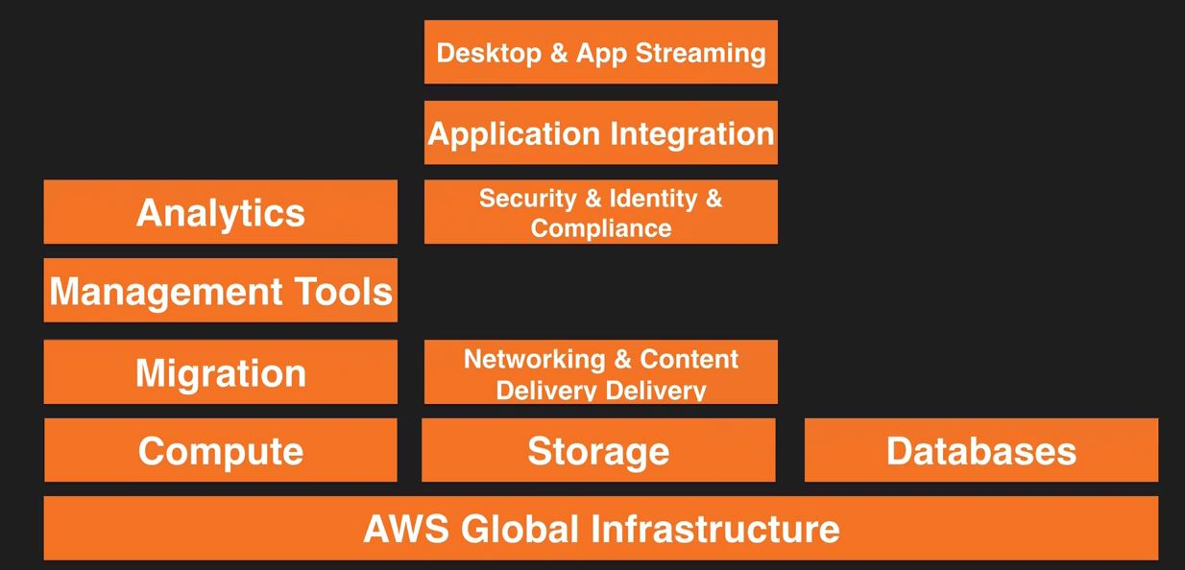
AWS Services– A Brief Overview
Services that are relevant for this course are as follows

Slide 31
AWS Services– A Brief Overview
How to create an AWS free tier account
AWS Console
The account that we use to sign up becomes the root account for your AWS account
Once you have entered all the details you are prompted for your Credit/Debit card information
Phone verification is done post you enter your Credit/Debit card information
Select the support plan (Free)
Once setup you should be able to login using your credentials of your root account

Slide 32
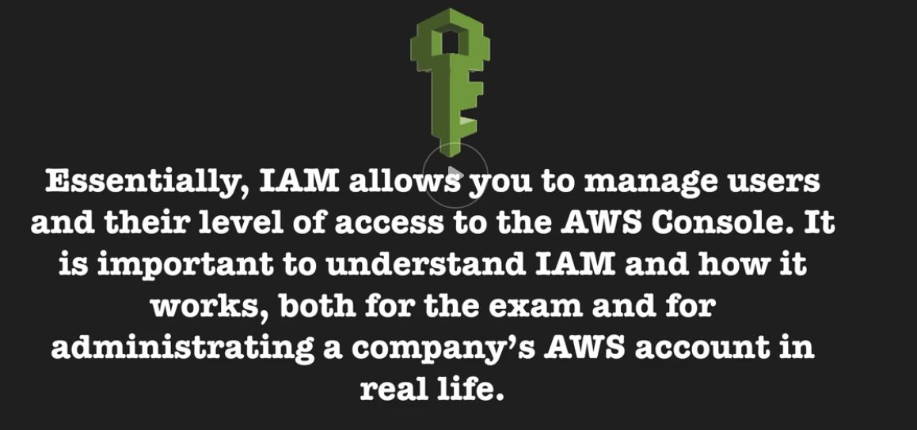
AWS Services– A Brief Overview
Identity & Access Management
It is the best place to start in AWS it is the place to setup your users and granting those users necessary permissions on the AWS resources
IAM is global. it is not specific to a particular region

Slide 33
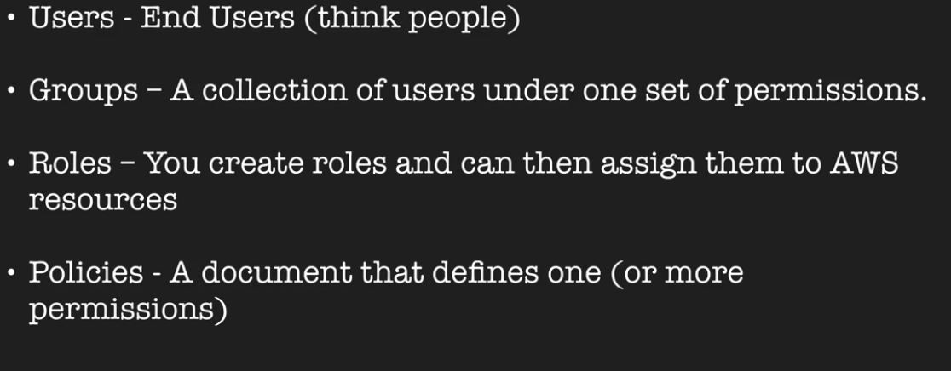
AWS Services– A Brief Overview
Important terms related to IAM

Slide 34
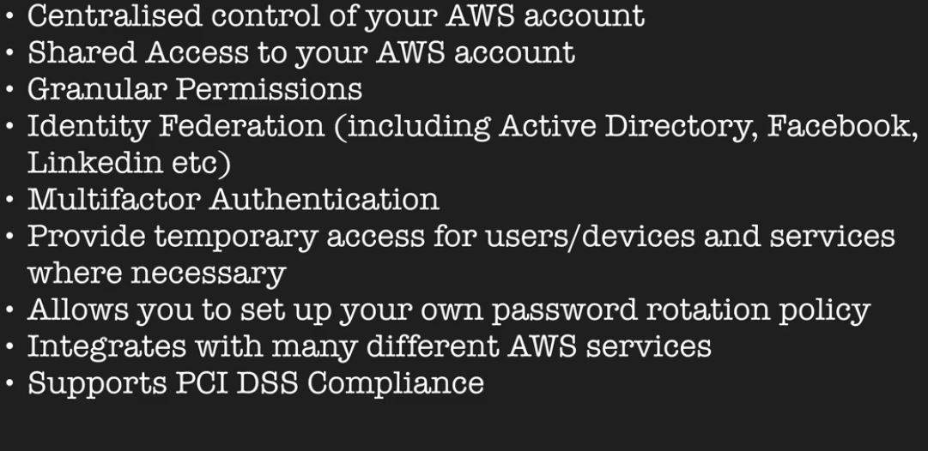
AWS Services– A Brief Overview
What does IAM provides as a service ?

Slide 35

AWS Services– A Brief Overview
What is the best way to learn any thing ?
Let’s start our first Lab and login to the AWS console

Slide 36
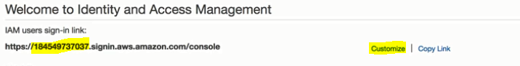
AWS Services– A Brief Overview
Identity & Access Management
The number that you see refers to your unique AWS account # and you can customize that to any DNS space provided that DNS namespace is available for use
Root account gives you unlimited access on your account
Hence it is recommended that one should not use root account rather create individual users and assign permissions
One should also enabled MFA in case our email address or password gets compromised this would serve as an additional layer of security
You can use google authenticator and as we setup in OKTA we have to do the same over here to enable MFA
New users have no permissions when they are first created
Note :- Root account is the email address that you use to sign up for AWS

Slide 37
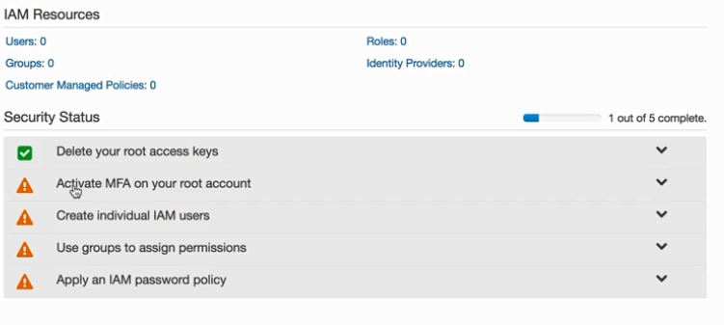
AWS Services– A Brief Overview
Identity & Access Management

Slide 38
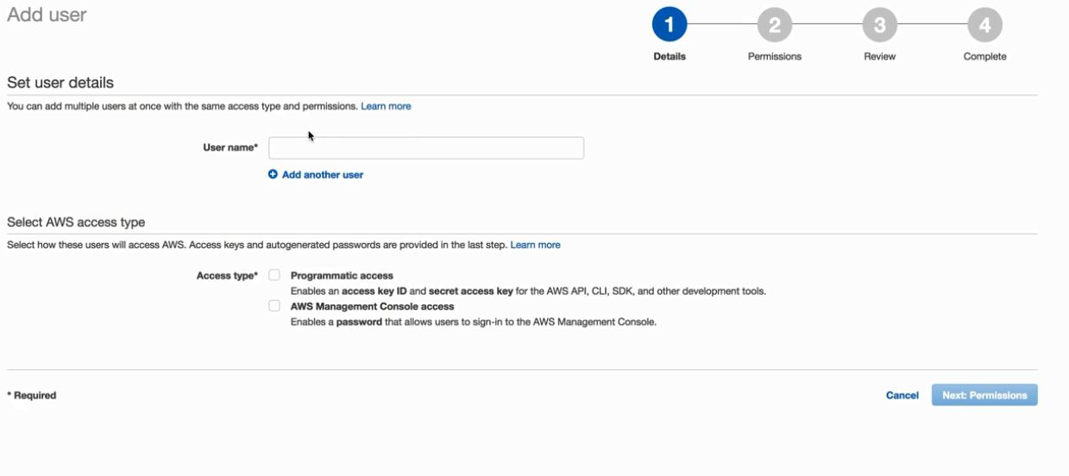
AWS Services– A Brief Overview
Identity & Access Management
How to create users in IAM

Slide 39
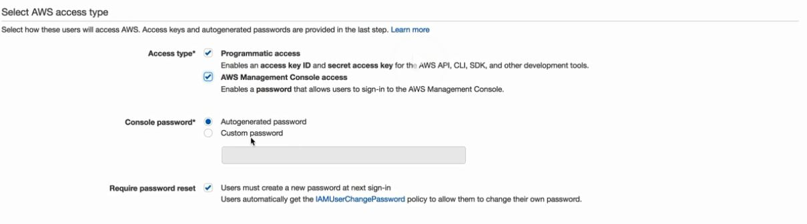
AWS Services– A Brief Overview
Identity & Access Management
How to create users in IAM

Slide 40
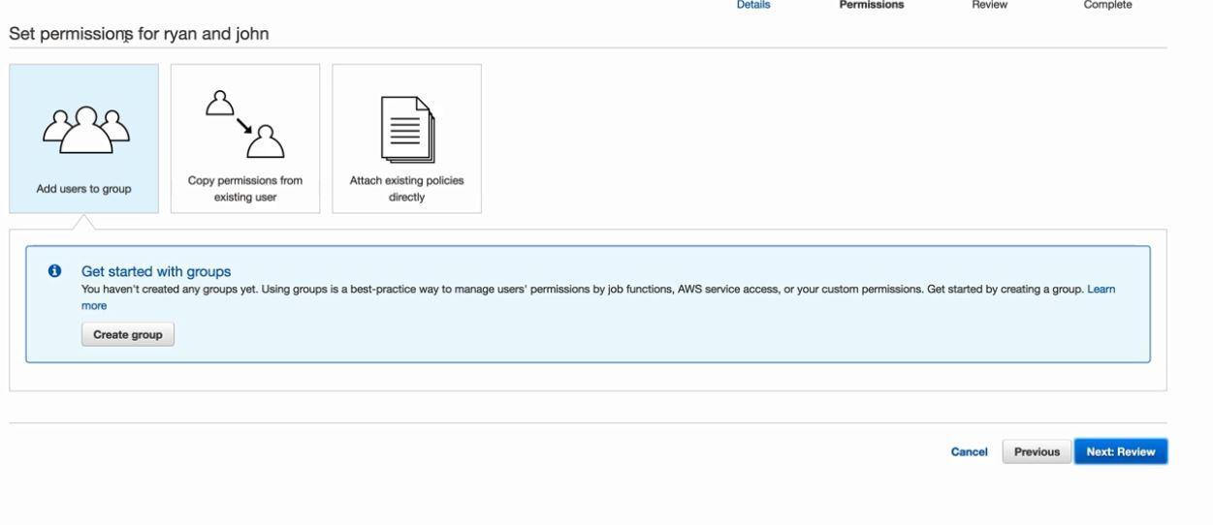
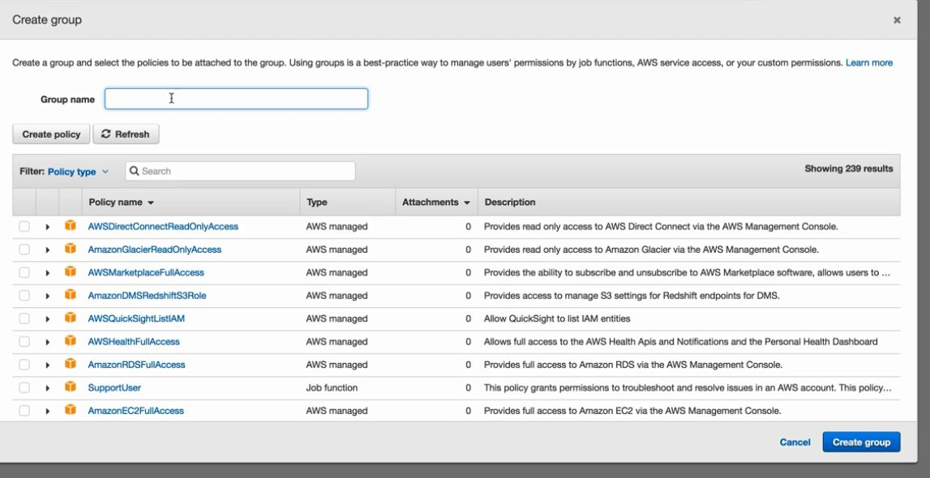
AWS Services– A Brief Overview
Identity & Access Management
How to create groups in IAM

Slide 41
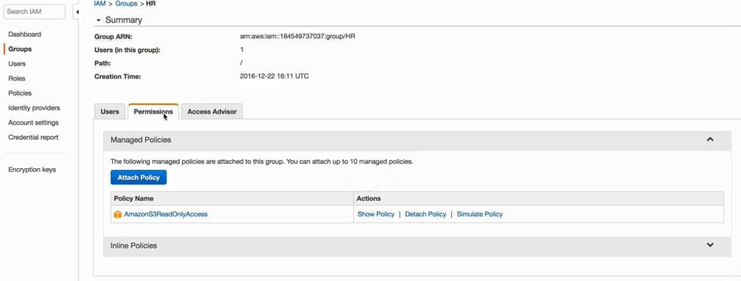
AWS Services– A Brief Overview
Identity & Access Management
Access key id and secret access key is the token to authenticate for programmatic access
You can install CLI tools and using these tokens you can upload an image to S3 or download it to your local machine
You will only see these access key only once and in case you loose them make the access key invalid and create a new pair of access key for the use

Slide 42
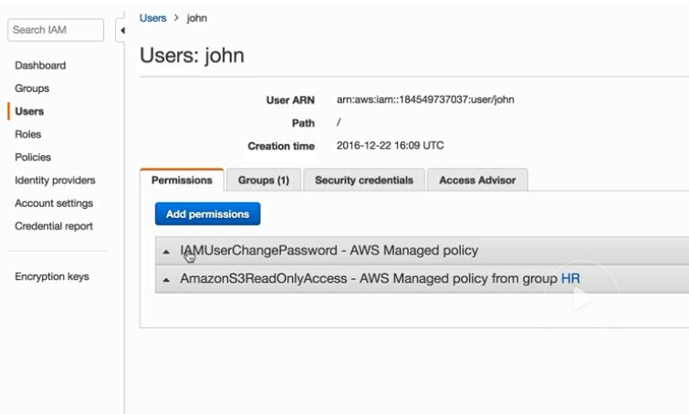
AWS Services– A Brief Overview
Identity & Access Management
You can also assign multiple policies to a user either standalone or through a group
A user can be added to multiple groups going into the users properties we can check the permission as in what permissions are applied similarly we can do this via groups
NOTE :- You can attach permissions to users as well as groups

Slide 43
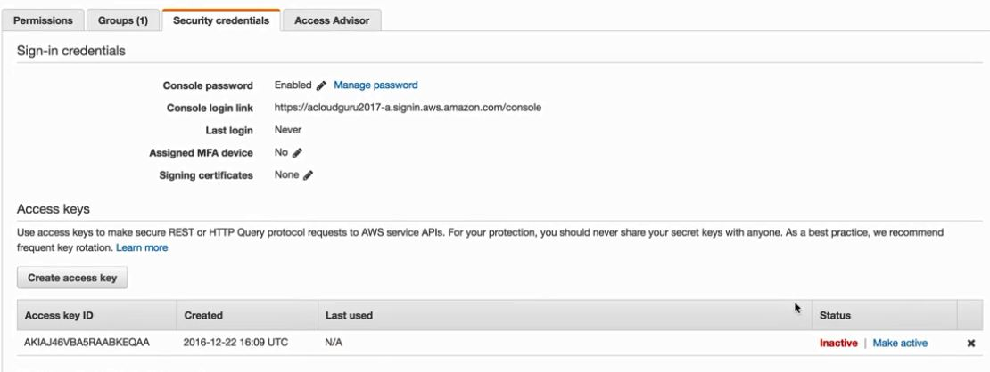
AWS Services– A Brief Overview
Identity & Access Management
We can create another access key by going in to users properties and going through Security credentials

Slide 44
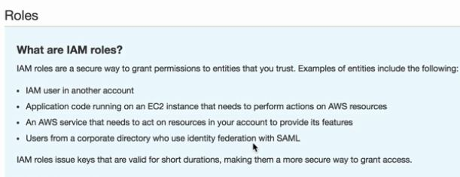
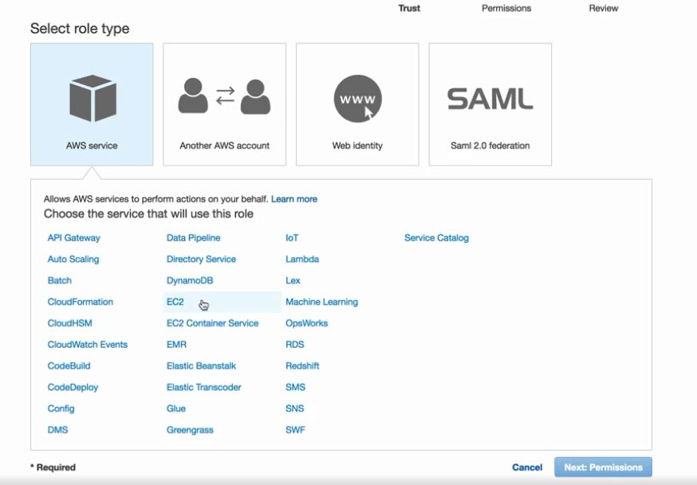
AWS Services– A Brief Overview
What is an IAM Role & how to create it
Roles are used to provide access to AWS resources to acess other services

Slide 45
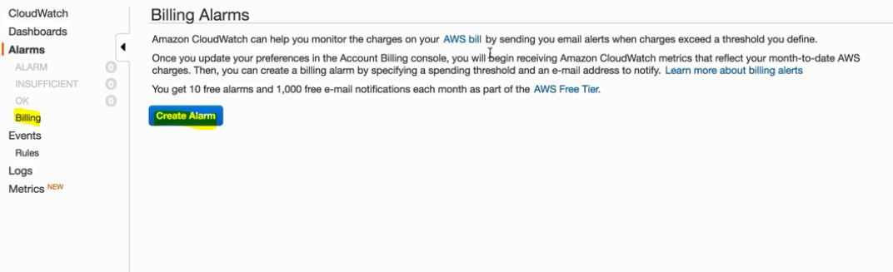
AWS Services– A Brief Overview
Create a billing alarm
Create a billing Alarm
From your account settings go to my billing dashboard and then under alerts and notifications then select Enable now
Choose your preference and save, once enabled the preferences it cannot be disabled
In Cloudwatch under billing you can create a billing alarm
Note :- Once you create an alarm you have to confirm the email address you get 72 hours to do that

Slide 46
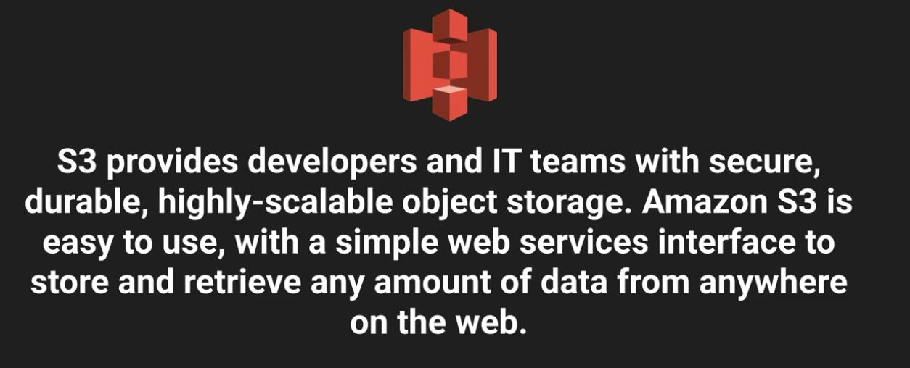
AWS Services– A Brief Overview
Simple Storage Service
What is S3 ?
S3 is a place to store your files on the cloud, generally this is object based storage
Dropbox leverage S3 for the storage of the metadata
Object based storage are generally documents, images these are called flat files
S3 is not a place where you can install an OS or a database for that you need block based storage

Slide 47
AWS Services– A Brief Overview
Simple Storage Service
What is S3 ?
The data is spread across multiple devices across multiple facilities, that provides high availability. it's designed to withstand failures
you can also get application from cloudberry labs that gives you an UI like an windows explorer wherein the data is being stored in S3
S3 has a universal namespace that means the name should be unique globally. When you create a bucket it is in the below format
https://s3-<region-name>.amazonaws.com/<bucketname>
or
http://<bucketname>.s3-aws-<region-name>.amazonaws.com

Slide 48
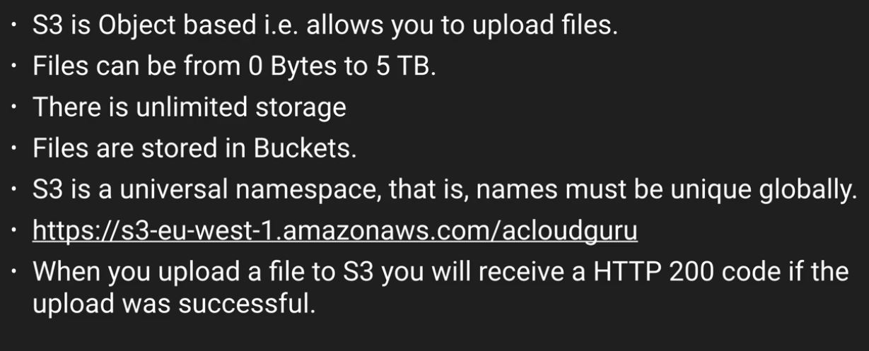
AWS Services– A Brief Overview
Simple Storage Service
S3 Basics

Slide 49
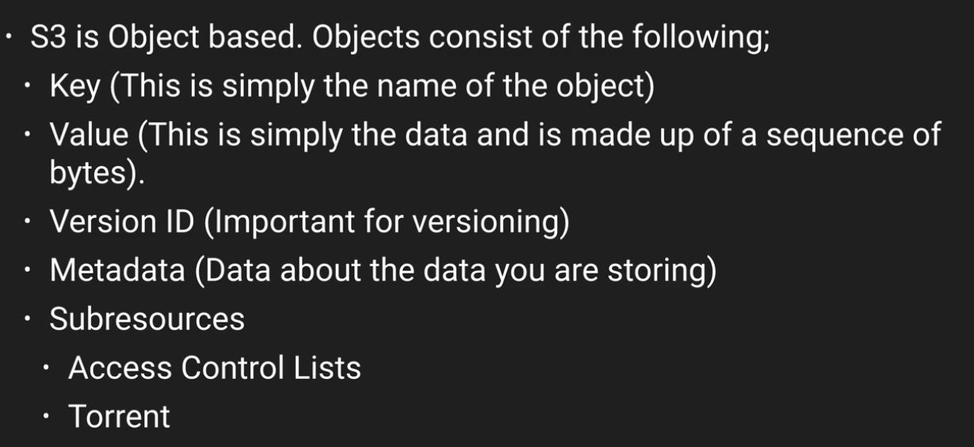
AWS Services– A Brief Overview
Simple Storage Service
S3 is a key value storage service
S3 is designed to be lexographic so as to sort content alphabetically. if you are storing logs in S3 and all the files for log data is very similar
So the data would be present somewhere at the same location and this can cause bottlenecks in order to come up with that you can add some salt to the file name
Subresources exist underneath object, you can use ACL at an object level or at the bucket level

Slide 50
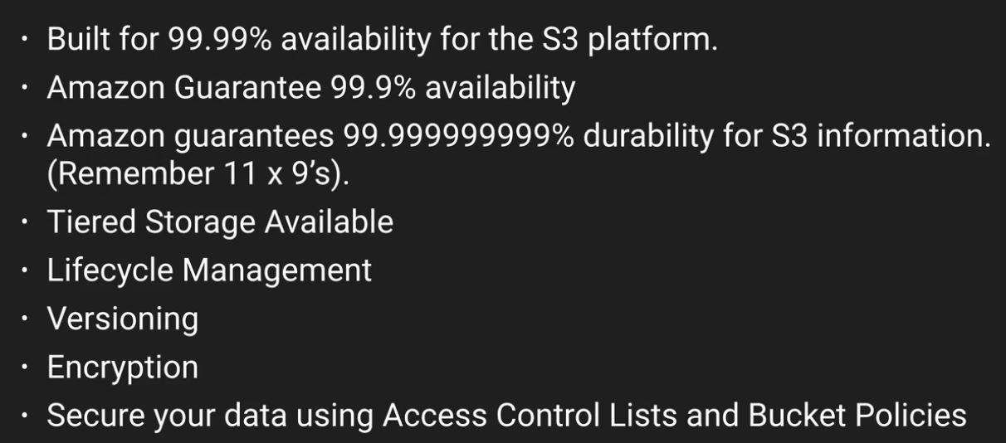
AWS Services– A Brief Overview
Simple Storage Service
S3 data consistency model
Read after write consistence for PUTS of new objects
Eventual consistency for overwrite PUTS and DELETES.
So in case if you are updating the object and you are accessing the object within miliseconds you may get new data or you may get old data, but you will not corrupt data

Slide 51
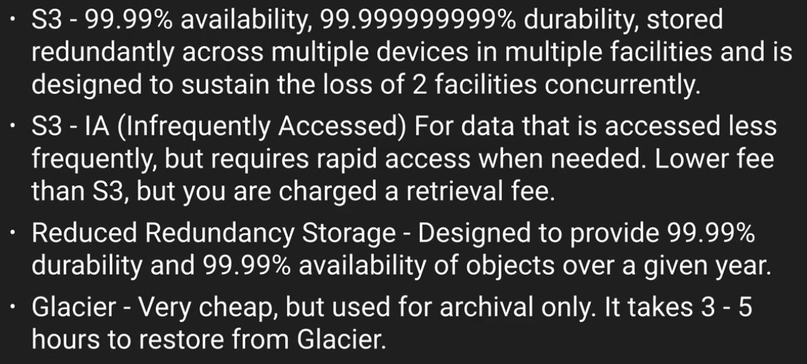
AWS Services– A Brief Overview
Simple Storage Service
S3 Storage classes

Slide 52
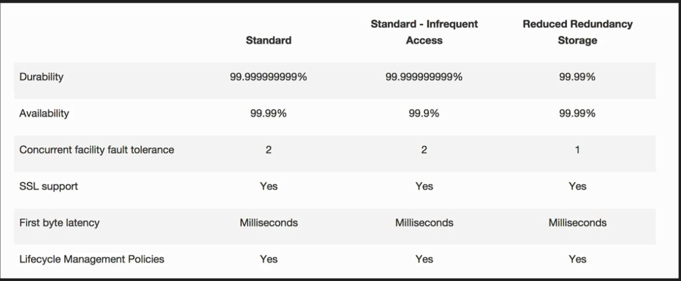
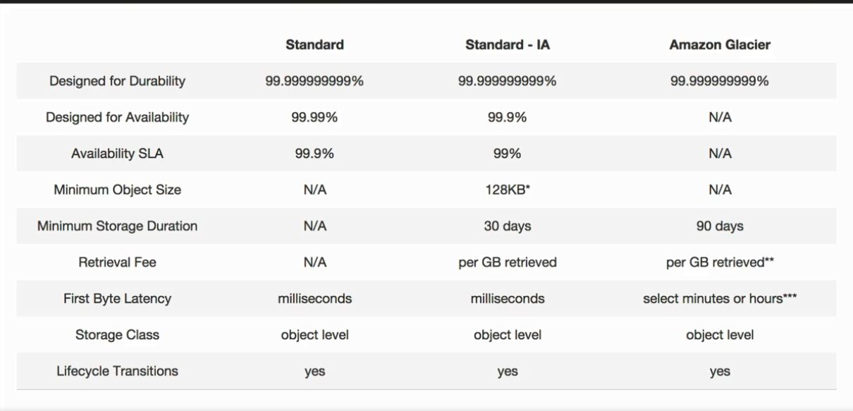
AWS Services– A Brief Overview
Simple Storage Service
S3 Storage classes comparison

Slide 53
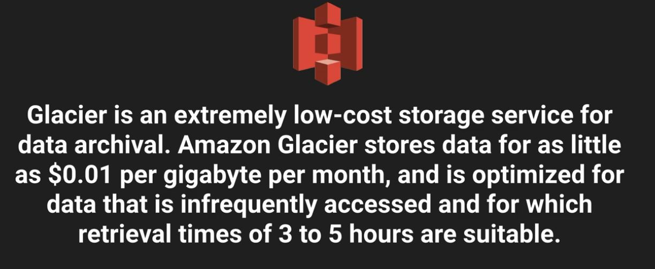
AWS Services– A Brief Overview
Simple Storage Service
Glacier

Slide 54
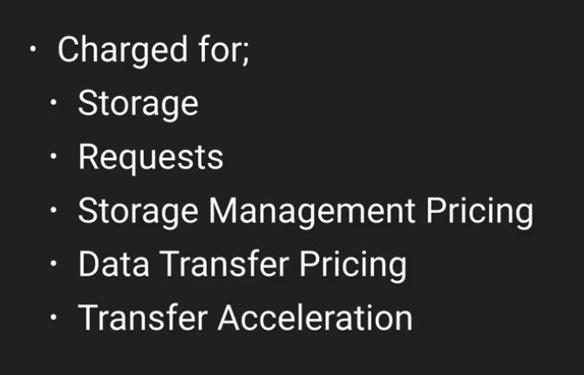
AWS Services– A Brief Overview
Simple Storage Service
S3 Pricing
Note :- Data coming into s3 is free. moving data within regions is charged

Slide 55
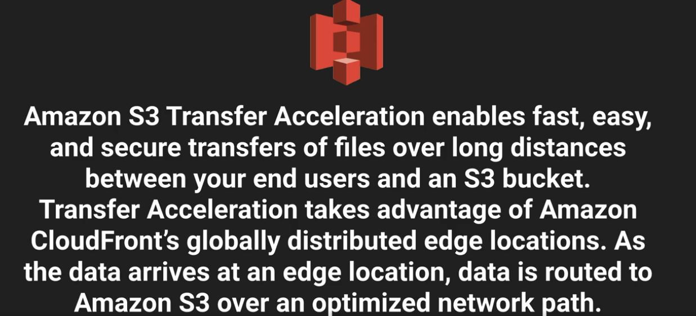
AWS Services– A Brief Overview
Simple Storage Service
Transfer Acceleration

Slide 56
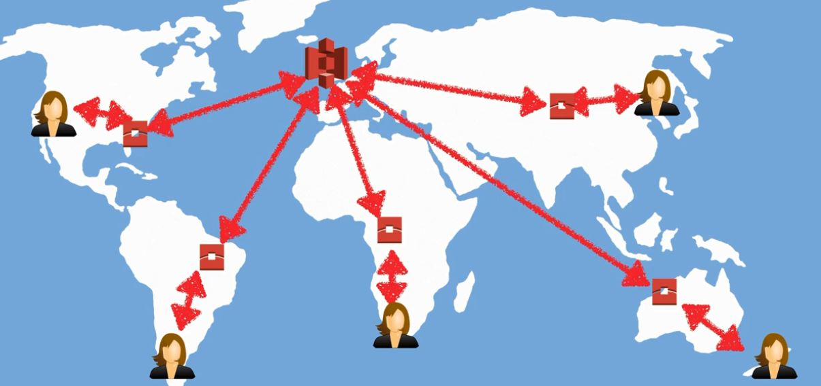
AWS Services– A Brief Overview
Simple Storage Service
Transfer Acceleration with example

Slide 57
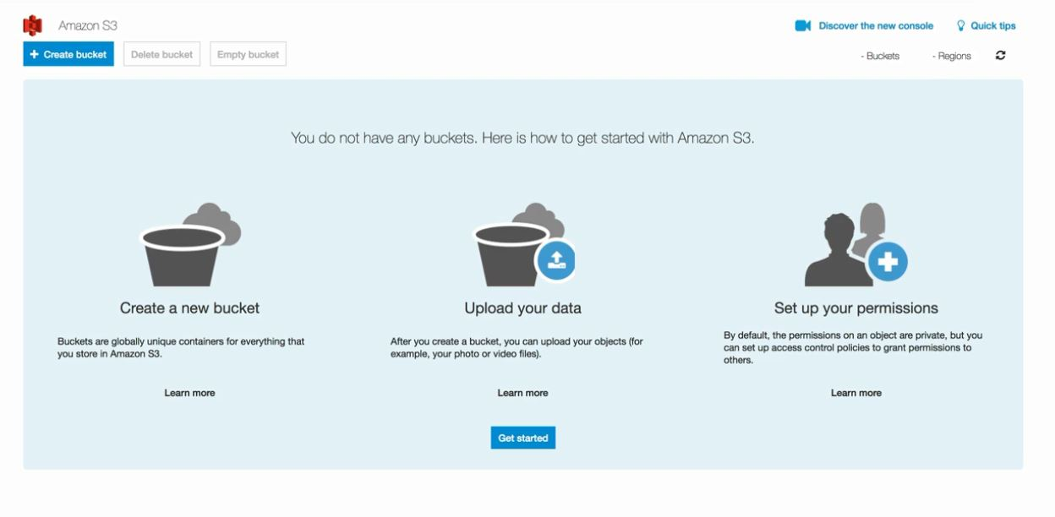
AWS Services– A Brief Overview
Creating a S3 bucket
S3 buckets are global, you can see all your buckets at one place
your bucket name should be unique, as it uses a DNS namespace and you can access this bucket using your browser
by default all buckets are private you can make it public via the permissions

Slide 58
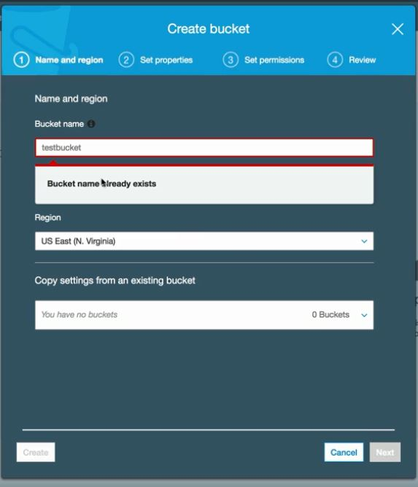
AWS Services– A Brief Overview
Creating a S3 bucket
If you upload anything to S3 via the CLI you will get HTTP200 code for any success
You can make the individual object in the bucket as public

Slide 59
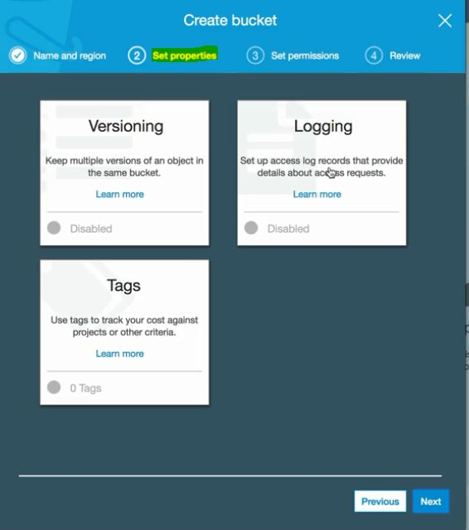
AWS Services– A Brief Overview
Creating a S3 bucket
Setup properties while creating a bucket
Note :- Object in the bucket don't inherit the bucket tag

Slide 60
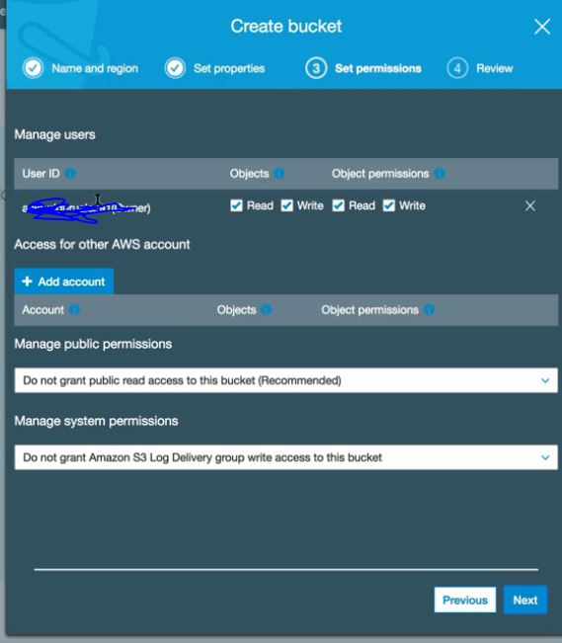
AWS Services– A Brief Overview
Creating a S3 bucket
Setup permissions while creating a bucket

Slide 61
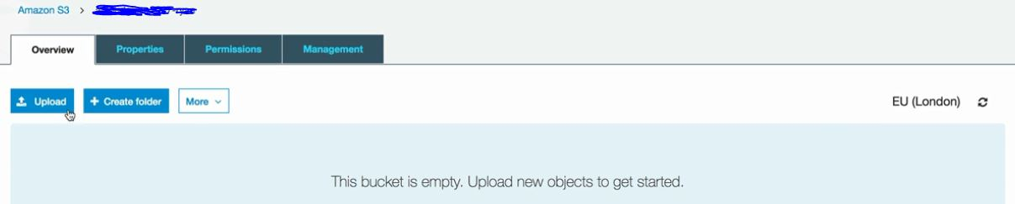
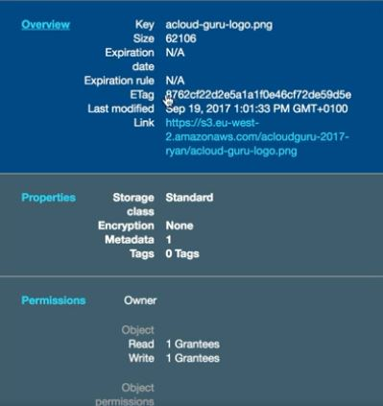
AWS Services– A Brief Overview
Creating a S3 bucket
Upload any object in a bucket
Click on the object to check the details of the object
Note :- In order to make an object public select the object click on more and then select make public

Slide 62
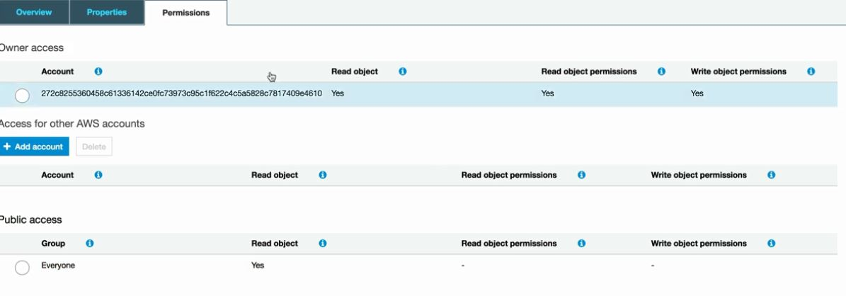
AWS Services– A Brief Overview
Creating a S3 bucket
Permissions of a object
You can also check about the permissions of the object by clicking on permissions from overview

Slide 63
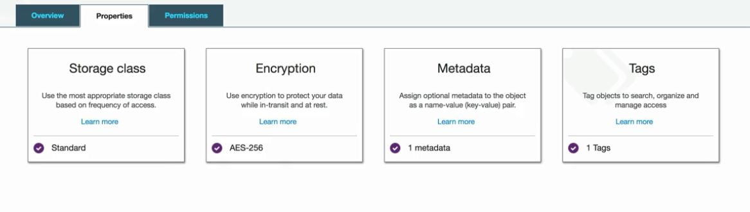
AWS Services– A Brief Overview
Creating a S3 bucket
Properties of an object

Slide 64
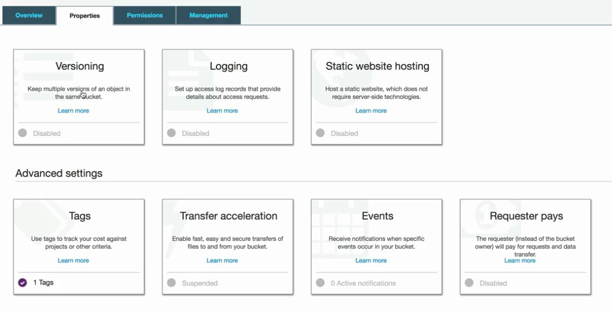
AWS Services– A Brief Overview
Creating a S3 bucket
Properties of the bucket
Note :- By default everything is disabled at the bucket level
Note :- Transfer acceleration is done at bucket level

Slide 65
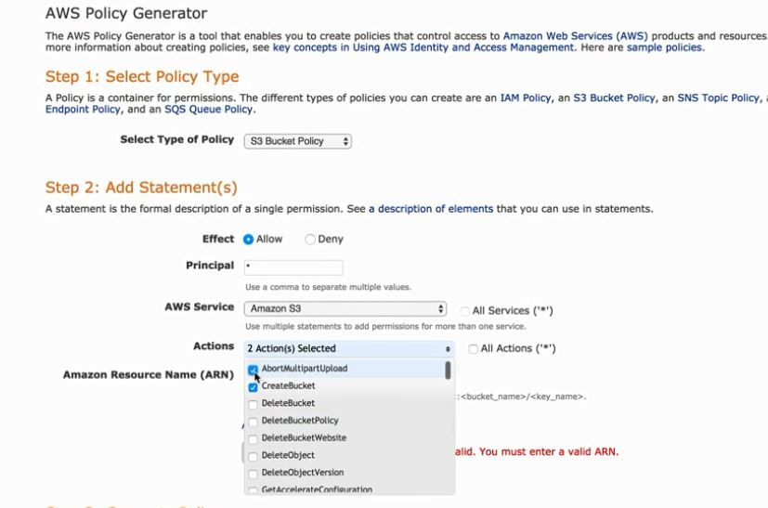
AWS Services– A Brief Overview
Creating a S3 bucket
There are two ways to control access controls to your bucket
Access control list & Bucket policy
You can create custom policy via the policy generator

Slide 66
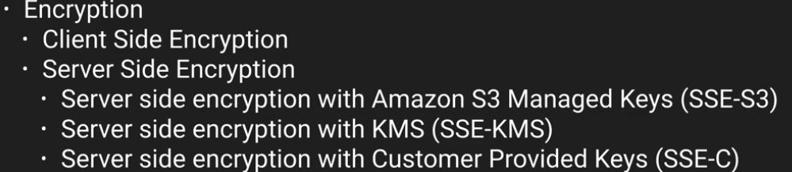
AWS Services– A Brief Overview
S3 Encryption
In transit(to and from your bucket using TLS/SSL) and data at rest
Server side encryption
S3 managed keys :- each object is encrypted by a unique key and then the keys are encrypted by using a master key and master key is rotated using AES-256
KMS :- Key management service extra cost as SSE-S3 advantage several permissions for the master key provides the audit trail as to when the key is being used
Customer provided keys :- management of keys done by customer
Client side encryption :- encrypt data at your end

Slide 67
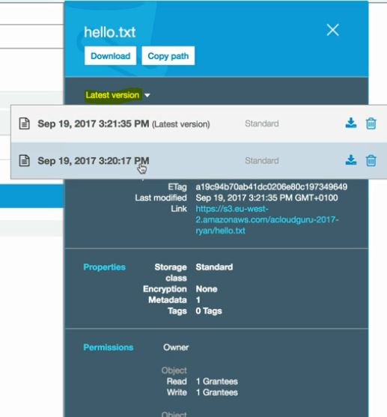
AWS Services– A Brief Overview
S3 Versioning
Once versioning is enabled you cannot disable that you can only suspend that
Versioning creates a copy of the file with every change in the file and the storage space adds up to all the spaces
When versioning is enabled all versions add up to the space and when you delete the object a delete marker is placed at the object and all versions of the objects are still there.
You can click on the previous versions in order to see the properties

Slide 68
AWS Services– A Brief Overview
S3 Versioning
there are two ways to restore the file
Download the version that you want to restore and upload it back again to the bucket
the other way to restore is to delete the latest version and that would be rolling back to one step behind.
If an object is deleted it does not delete the object.it just pust a delete marker
If you delete the delete marker that would restore the object to the last version when it was deleted
When you click on show it shows all the version of the objects
You can configure for MFA delete for additional layer of security
It integrates with lifecycle rules
Versioning documentation
Note :- Versioning is done at bucket level

Slide 69
AWS Services– A Brief Overview
S3 Cross region replication
Replicating objects from one bucket to other bucket in a different region
In order to CRR to work versioning should be enabled at both ends at the buckets
An IAM role is needed for CRR
New objects and any objects that are changed will be replicated, so any objects that are already there will not be replicated
In order to move all the files from one bucket to another we use AWS CLI
Install AWS cli tools on your machine
In order to access S3 through CLI type AWS configure and provide access key id. Depending on the access key id for the user the necessary permission is granted on the aws services
So in case you have a user who is not allowed to access S3 and you have provided the access key id of that user while configuring the aws cli that won't work
aws s3 cp --recursive <source-bucket> <destination-bucket>
Permission are replicated for new objects in CRR
Once we delete a object in the source bucket delete marker is replicated

Slide 70
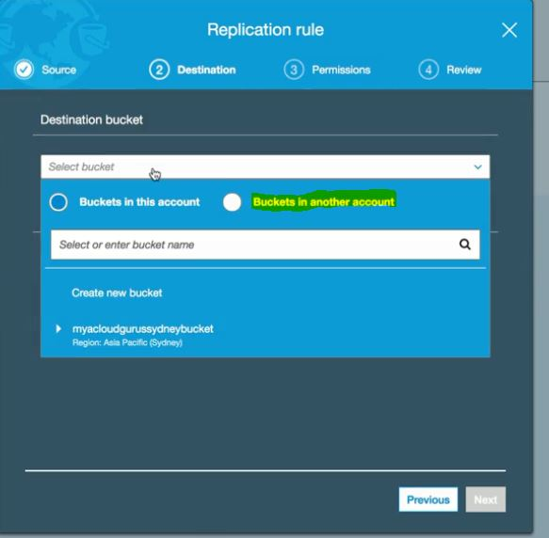
AWS Services– A Brief Overview
S3 Cross region replication
wherein deleting the delete marker (restoring the object after the delete) it is not replicated to the destination bucket
Deleting a version is not replicated from source to destination
You cannot replicate to multiple buckets or create daisy chain

Slide 71
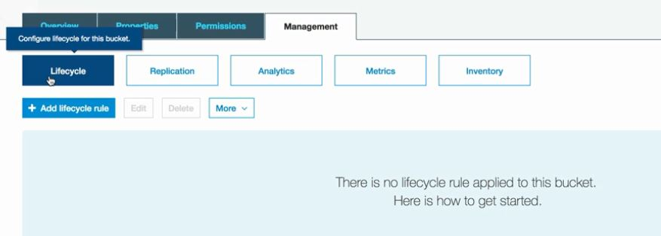
AWS Services– A Brief Overview
S3 Lifecycle management
It is moving an object from one storage class to another automatically by setting up rules
You can also set the object to expire using lifecycle management
Versioning is not needed for lifecycle management but in case you are using versioning on your bucket lifecycle can be integrated with versioning

Slide 72
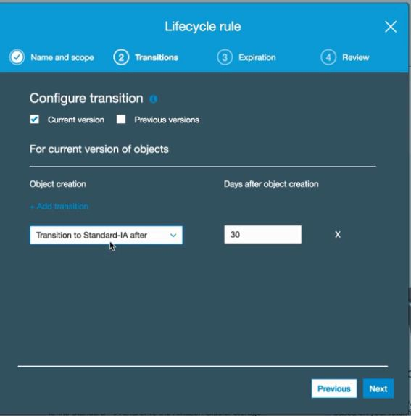
AWS Services– A Brief Overview
S3 Lifecycle management
Setting up lifecycle rules
NOTE :- For standard IA the object must be greater than 128 KB of size and it has to be 30 days after the object creation

Slide 73

AWS Services– A Brief Overview
Cloudfront
Cloudfront is the CDN network for Amazon.

Slide 74

AWS Services– A Brief Overview
Cloudfront Key terminology

Slide 75
AWS Services– A Brief Overview
Cloudfront
There are essentially two types of distribution
Web distribution :- Used for websites
RTMP :- used for streaming media
A CDN network helps in speeding up the delivery of the content across the world
How CDN works ?
Whenever a request is made by an end user it first goes to the edge location to check for the requested content
In case the content is not found at the respective edge location it is then pulled down from the origin and cached at the edge location for the define TTL
TTL is nothing but the time content would stay at edge location.
NOTE :- Edge location are not just read only you can also upload content to them

Slide 76

AWS Services– A Brief Overview
Cloudfront
How Cloudfront works ?

Slide 77


AWS Services– A Brief Overview
Cloudfront

Slide 78
AWS Services– A Brief Overview
Cloudfront
Once the object is cached at an edge location it remains over there until the TTL expires, you can remove the content from the edge location before the TTL expire you have to invalidate the object first and you would be charged for that.
Create a Cloudfront distribution
We would have an origin as an S3 bucket. However we can have multiple origin per distribution.
You can also have servers that are hosted on prem inside your own DC
First things first
We would create an s3 bucket which would serve as an origin for our cloudfront distribution
Once the bucket is created upload any file in the bucket
Make the file public for the object and then upload the object in the bucket

Slide 79

AWS Services– A Brief Overview
Let’s Navigate to the Cloudfront section in the console
Cloudfront is under the networking section

Slide 80

AWS Services– A Brief Overview
Cloudfront
Origin domain name :- where the origin comes from
It can be your AWS S3 bucket or an ELB or you can enter your on prem server address
Origin path :- adding multiple subfolders within that origin
Origin id- origin id name
Restrict bucket access :- what this essentially means stop people using that S3 url, even if the object is not publicly accessible cloudfront would be able to deliver that content
In order to restrict bucket access we have to create an OAI
What this essentially does it creates an user just like "everyone" and you apply permission to that user and this users is only called when cloudfront makes a call to origin

Slide 81

AWS Services– A Brief Overview
Cloudfront
Also after that please update the bucket policy if this is not done you have to grant this user permission manually
Path pattern :- this allows us to set a path pattern in case of multiple origin serving the content
GET,HEAD,PUT, POST, PATCH,DELETE is used to upload the contents to edge location
TTL :- it is the time which is defined in seconds and the object is stored in the edge location, TTL is always in seconds
Min value :- 0
Max:- 365 days
default :- 24 hours
Restrict Viewer access :- using signed url you can restrict viewer access where in only those users can access who has access to that URL

Slide 82

AWS Services– A Brief Overview
Cloudfront
You can actually use WAF to prevent SQL injection, this provides an additional layer of security at layer 7
In case you are using your own SSL you have to purchase it and save it in SSL cert manager or in case you are using Route53 you can get SSL cert free
NOTE :- Cloudfront takes some time to provision a distribution

Slide 83

AWS Services– A Brief Overview
Cloudfront
You can create custom error codes
Domain name :- is the URL that you need to access to get the content
You can also setup geolocation restriction you can either have blacklist or whitelist. You can have only one at a time
Invalidation :- It is used to remove objects from edge location before their TTL expires
In order to delete a distribution you first have to disable that and then delete that

Slide 84

AWS Services– A Brief Overview
S3 : Security and Encryption
Key security concepts for S3 bucket

Slide 85

AWS Services– A Brief Overview
S3 : Security and Encryption
In transit(to and from your bucket using TLS/SSL) and data at rest
Server side encryption
S3 managed keys :- each object is encrypted by a unique key and then the keys are encrypted by using a master key and master key is rotated using AES-256
KMS :- Key management service extra cost as SSE-S3 advantage several permissions for the master key provides the audit trail as to when the key is being used
Customer provided keys :- management of keys done by customer
Client side encryption :- encrypt data at your end

Slide 86

AWS Services– A Brief Overview
Storage Gateway
Storage gateway is a service that connects on-prem software appliance with cloud based storage
Service enables you to store data to the AWS cloud
Storage gateway is nothing but a virtual appliance that you install on a hypervisor running on your own DC
That VM would asynchronously replicate the information up in AWS
4 type of storage gateway

Slide 87

AWS Services– A Brief Overview
Storage Gateway

Slide 88
AWS Services– A Brief Overview
Storage Gateway
4 type of storage gateway
File Gateway(NFS) :- Used for flat files in S3
Volume gateway :- Block based devices (iscsi). This is using block based storage, this is using storage that you would run OS on. It might be a VHD on which you are running a VM or a VHD wherein you have a SQL server running on. Essentially these will not be stored in S3
Stored volume :- this is where you store an entire copy of your dataset in AWS
Cached volume :- You only store most recent accessed data in on prem and the rest is at AWS
VTL :- Tape gateway backup and archive solutions creates virtual tapes and send them to S3. and you can use lifecycle policies to send those to glacier

Slide 89


AWS Services– A Brief Overview
Storage Gateway
File Gateway

Slide 90
AWS Services– A Brief Overview
Storage Gateway
Your application servers and storage gateway need not to be an on prem it can be within your VPC
It can be installed on an EC2 instance and sending the data to S3 and then once the data is on S3 you can configure lifecycle policies

Slide 91

AWS Services– A Brief Overview
Volume Gateway

Slide 92

AWS Services– A Brief Overview
Volume Gateway
Volume gateway present your application with disk volumes using iSCSI. Data written to this can be stored as point In time snapshots as EBS Snapshots in S3, i.e. Volume gateway stored VHD from on prem to AWS cloud as snapshot
Snapshots are incremental and storage is also compressed

Slide 93

AWS Services– A Brief Overview
Volume Gateway
You create a storage volume and its a virtual storage. this virtual hard disk is provisioned by the storage gateway. and you mount it to your application servers
Volume gateway Stored volumes uses the hardware (on prem)and creates iscsci block devices as VHD to be used by the application server. And also uploads the snapshot in upload buffer to be transferred over to the AWS cloud
In upload buffer these VHD are converted as snapshots and are uploaded via the upload buffer as multipart upload

Slide 94

AWS Services– A Brief Overview
Volume Gateway-Cached Volumes
Cached volume iscsi block devices are created at AWS and application server connect to them as VHD

Slide 95

AWS Services– A Brief Overview
Volume Gateway-Cached Volumes
NOTE :- 1 Gb- 16 Gb in size and for cached volume it is upto 32 TB

Slide 96

AWS Services– A Brief Overview
Virtual Tape Gateway

Slide 97

AWS Services– A Brief Overview
Virtual Tape Gateway
It uses your existing tape based backup application infrastructure to store data on virtual tape that you create on tape gateway
tape gateway consist of media changer and tape drives which are avaialable to your application server as iscsci block devices

Slide 98

AWS Services– A Brief Overview
Snowball
Before there was snowball there was import/export disk
This was used to transfer large amount of data into aws without using the internet

Slide 99

AWS Services– A Brief Overview
Snowball
There is three different types of snowball
Snowball
Snowball edge
Snowmobile

Slide 100

AWS Services– A Brief Overview
Snowball Edge
Snowball edge is same as a normal snowball but it comes with compute capacity. So you can export data and can run computing on that data. It's like a small portable DC that you can get

Slide 101

AWS Services– A Brief Overview
Snowmobile
Note :- if you are exporting data from glacier you would have to first retreive that and then after that you can move the data to the snowball
Note :- Snowball comes under migration in the console

Slide 102
AWS Services– A Brief Overview
Snowball-Key points
While creating your job you need to setup your s3 bucket and setup all the basic details
You would need the snowball client in order to interact with the snowball
In order to connect to snowball we would need the credentials
we get the credentials from the job
you get unlock code and get a manifest file in the credentials section
To start snowball → ./snowball start -i <IP Address of Snowball> -m <manifest file> -u <Unlock code>
To copy the content → ./snowball cp <filename> <s3://bucket_name that you have defined in the job>

Slide 103

AWS Services– A Brief Overview
Transfer acceleration
URL looks like
bucketname.s3-acelerate.amazonaws.com
In order to enable it you have to do it in the properties of the bucket level
Transfer acceleration leverage amazon CDN network

Slide 104
AWS Services– A Brief Overview
Create a Static website from S3
From the bucket properties we can select static website hosting
Syntax for website
$Bucketname.s3-website-$Region.amazonaws.com
Also make the object public else people won't be able to access it
It scales automatically
Note :- if you plan to use route53 with s3 and you have the domain and wants to use that domain name with S3 make sure your bucket name is exactly the same as your first level domain name. Domain name amir.com can be pointed to bucket name amir

Slide 105
Thank You
Presented by :- Amir Khan

